Slide 1
SEMINAR-II 2023-24
AMITY INSTITUTE OF INFORMATION TECHNOLOGY
Evaluating the Impact of Semantic Search Tools on Content Diversity
STUDENT NAME:
Saurav Kumar Suman
Dual 10
A1049519029
GUIDE NAME:
Dr. Misbah Anjum
1

Slide 2
OBJECTIVES
AMITY INSTITUTE OF INFORMATION TECHNOLOGY
How Does Contextual Meaning Impact Semantic Search?
How semantic search tools impact the diversity of content in search results.
Is Semantic Search Evolving Beyond Traditional Keyword Matching?
Identify the implications, challenges, and future of semantic search tools in meeting evolving user expectations for diverse and enriched content.

Slide 3
INTRODUCTION
AMITY INSTITUTE OF INFORMATION TECHNOLOGY
Evolution of Information Retrieval:-
Semantic search tools represent a transformative shift from traditional keyword-based search models.
Advanced natural language processing and machine learning capabilities distinguish these tools in understanding user queries.
Importance of Context-Aware Search:-
Semantic search goes beyond literal keyword interpretation, delving into the contextual nuances of language.
This approach promises a more sophisticated, context-aware, and user-centric search experience.
Role of Semantic Search in Diversity:-
Semantic search tools, equipped with an understanding of semantic intricacies, are positioned to cater to the demand for diverse content.

Slide 4
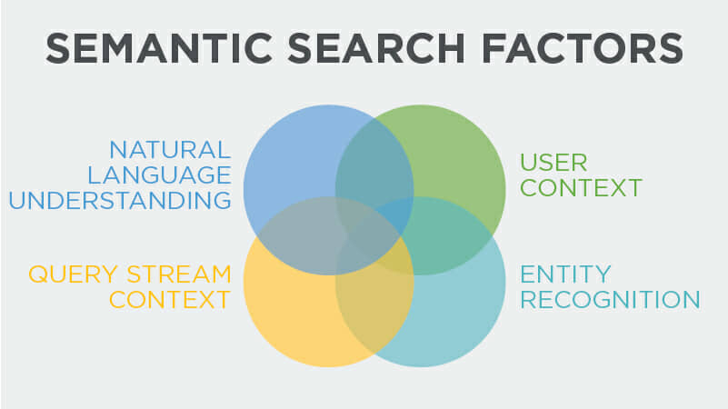
How Does Contextual Meaning Impact Semantic Search?
AMITY INSTITUTE OF INFORMATION TECHNOLOGY
Natural Language Understanding (NLU):
It enables the search engine to comprehend the nuances of human language, including syntax, semantics, and the relationships between words.
User Context:
It includes factors such as the user's search history, location, preferences, and behaviour to personalize search results.
Entity Recognition:
It identifies specific entities (e.g., people, places, organizations) mentioned in the query.
Query Stream Context:
It analyses the sequence of queries submitted by the user over time to infer the user's broader intent

Slide 5
How semantic search tools impact the diversity of content in search results.
AMITY INSTITUTE OF INFORMATION TECHNOLOGY
Semantic search tools play a crucial role in impacting the diversity of content in search results.
User Query: The user submits a search query.
Semantic Analysis: The semantic search tool analyzes the query to understand its intent and context.
Semantic Search Results: The tool returns search results that are more relevant to the user's query, considering the contextual meaning of the words.
User Query -> Semantic Analysis (Understanding Intent and Context) -> Semantic Search Results

Slide 6
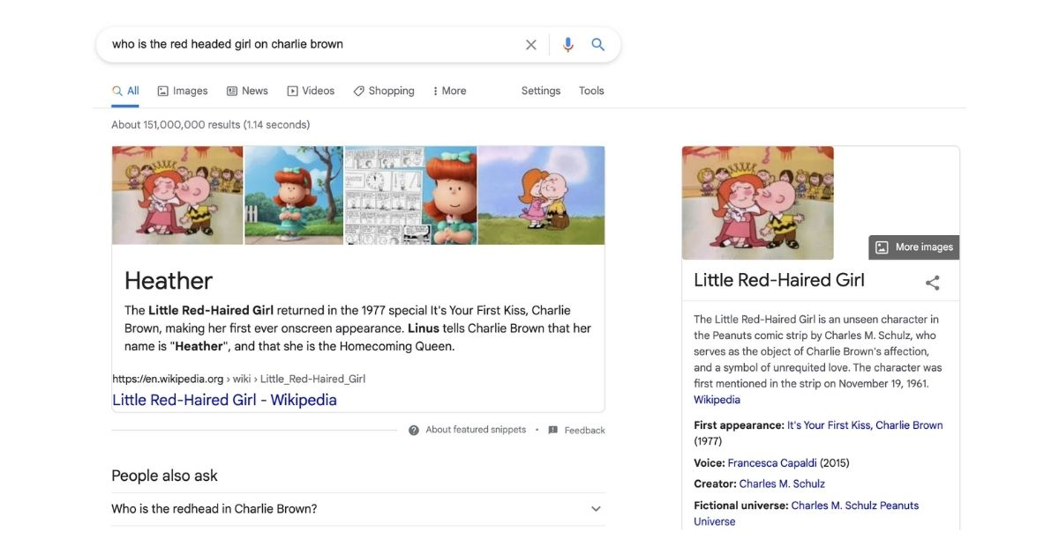
AMITY INSTITUTE OF INFORMATION TECHNOLOGY
Is Semantic Search Evolving Beyond Traditional Keyword Matching?
Intuitive: -
Solutions engage in the analysis, identification, and semantic structuring of unstructured data, encompassing both textual and video content
Example: - Imagine using Google to find a red-haired character in Peanuts, even if you don't know the character's name. You can just say, "red-headed girl," and Google gets it, telling you it's "Heather" in Peanuts.

Slide 7
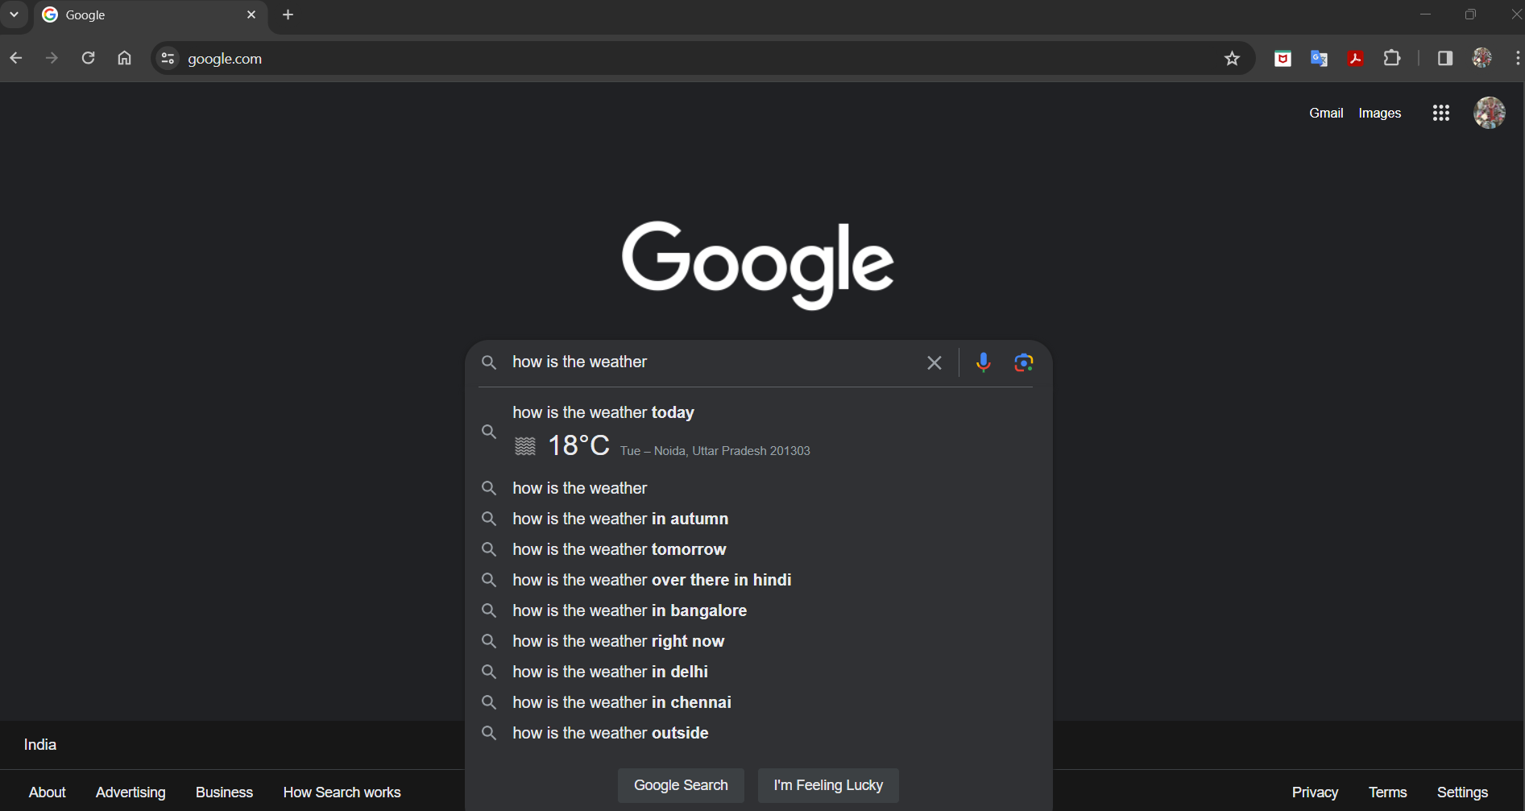
AMITY INSTITUTE OF INFORMATION TECHNOLOGY
Contextual: -
It aims to figure out what a user is looking for by considering their previous searches, even if they aren't directly connected to the current one.
Example: - When asking about the weather, smart search uses the user's past searches to suggest different ways of asking the same question, considering various locations the user has looked up or visited.

Slide 8
FUTURE TRENDS AND DEVELOPMENTS
AMITY INSTITUTE OF INFORMATION TECHNOLOGY
Enhanced Personalization:
Semantic search tools will likely become more adept at understanding user intent and preferences, leading to highly personalized search results
Multimodal Search:
As technology advances, semantic search tools may integrate more multimedia content such as images, videos, and audio files.
Semantic Context Understanding:
Future semantic search tools might focus on better understanding the context in which users search for information.
Content Curation and Verification:
Semantic search tools may play a role in content curation by surfacing high-quality, diverse content while filtering out misinformation and low-quality sources.

Slide 9
THANK YOU
AMITY INSTITUTE OF INFORMATION TECHNOLOGY

